Slide 1
University Of Michigan-Flint

Slide 2
Location of UM-Flint

Slide 3
Studying at um-flint
Exchange students arrive one week before the classes start for orientation week
Exchange students can earn 12 credit points = 4 classes
Classes mostly two times per week
Class requirements:
Quizzes, tests, essays, papers, homeworks, mid-terms, finals

Slide 4
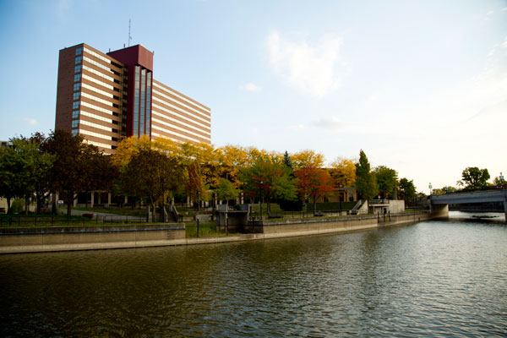
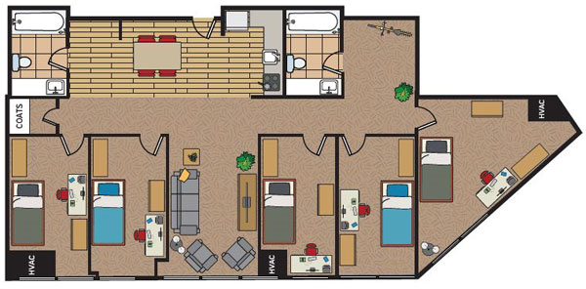
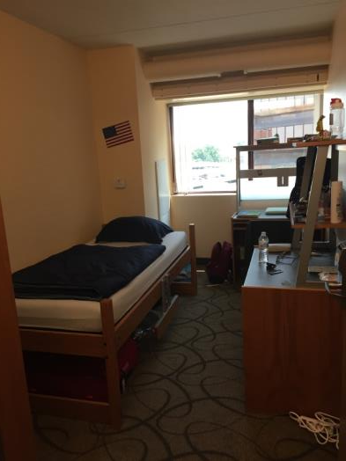
HOUSING AT RIVERFRONT
5-Person Single – 1-Person Studio rooms
Shared bathroom with one or two roommates
Small gym (open 24 hours)
Laundry room (washing machines & dryers)
Common room (TVs, pool tables, community kitchen with ovens)

Slide 5
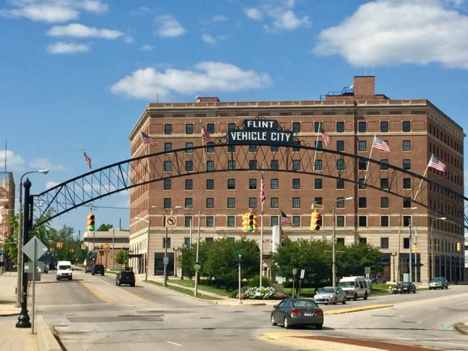
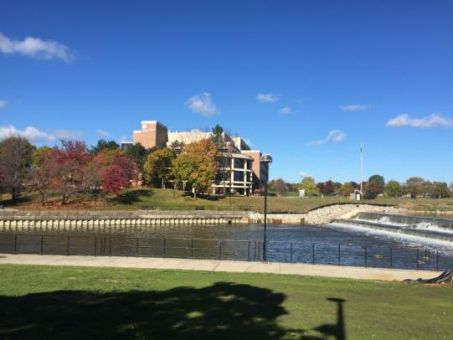
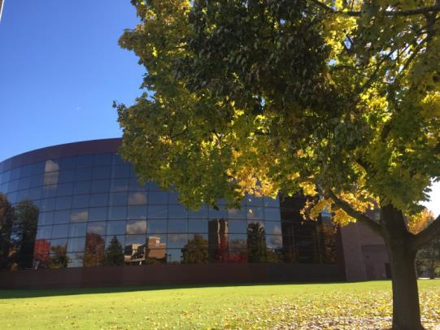
Flint
Recreation Center (swimming pool, hot tub, sauna, giant gym,…)
Events and activities hosted by the University on a regular basis (cinema nights, BBQs, dinners, parties, …)
Library
Bars and restaurants near campus (delicious American burgers and drinks)
Applewood Estate (orchard)
Farmers‘ Market
Walmart, shopping mall and outlet center a few minutes ride by car

Slide 6
Expenses
Flight: ca. 1200€
Visa: 350€ + travel expenses to embassy in Frankfurt (includes SEVIS)
Health Insurance: ca. 420€ (ISO – by UM-Flint; you can choose another one , but insurance must be accepted by the University)
Housing: 5-Person Single the cheapest one: ca. 3.100€
Books: 80€
Optional meal plan: 1.500€
Traveling, food, and other expenses will depend on you

Slide 7
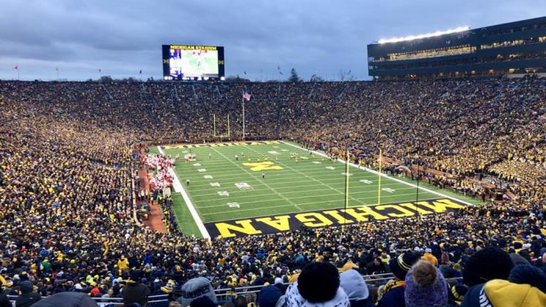
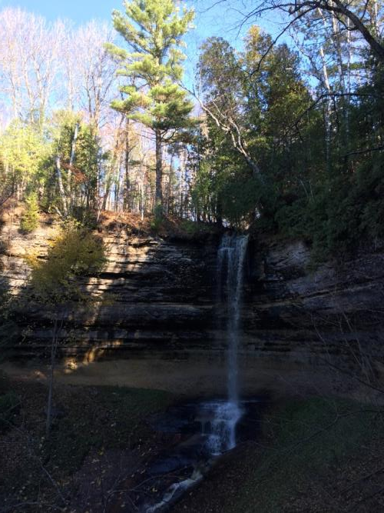
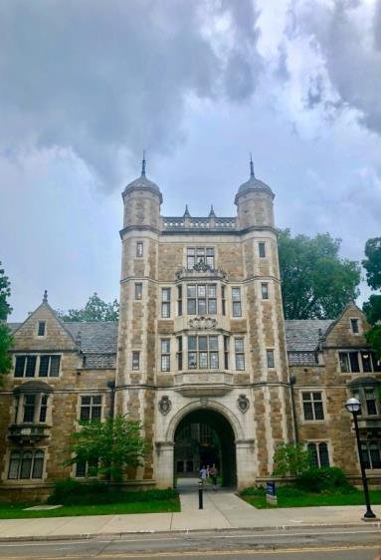
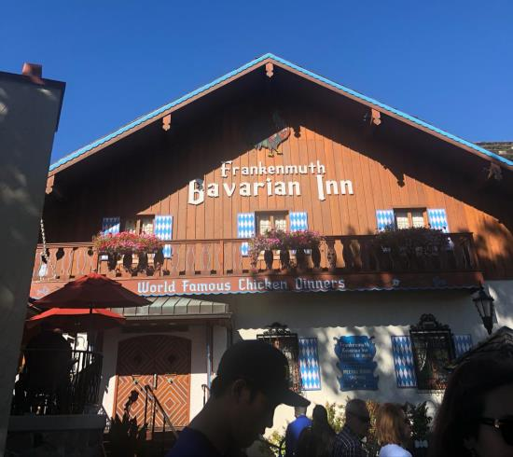
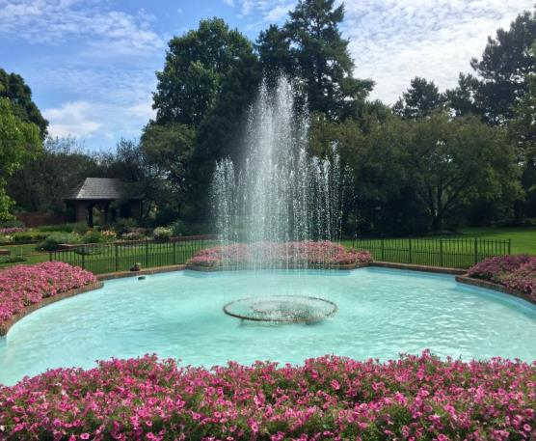
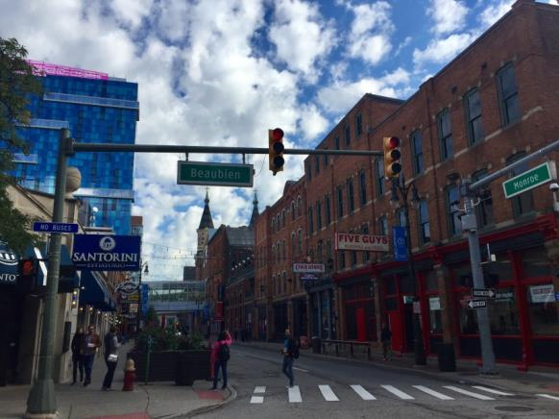
Travelling – in michigan

Slide 8
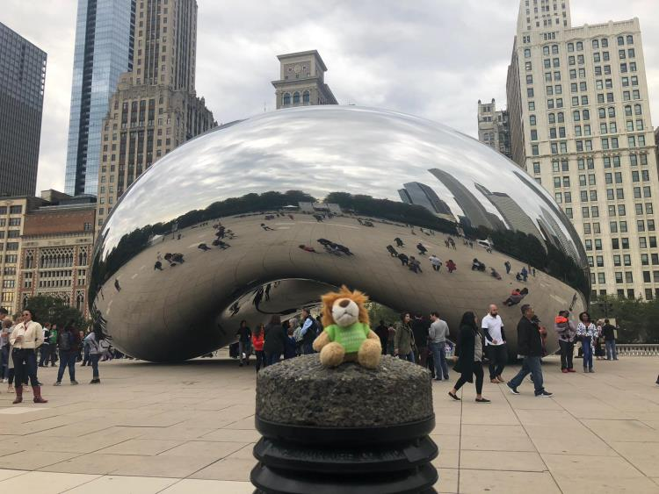
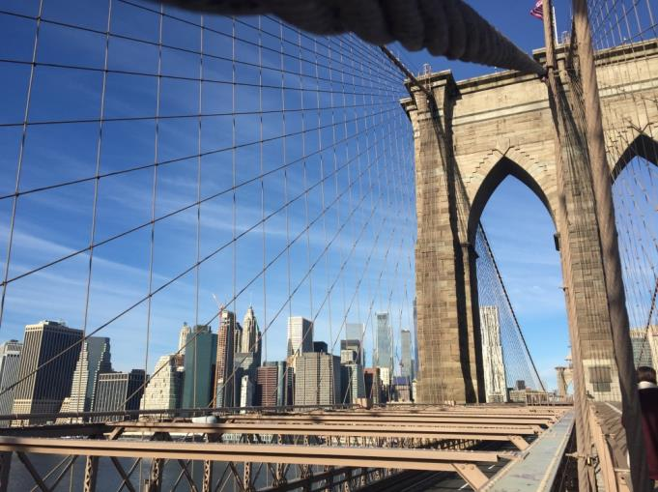
Travelling – outside of michigan

Slide 9
Contact
marah.hausmann@uni-wuppertal.de

Slide 10
Sources (Pictures)
Map: https://www.google.de/maps/search/michigan+um+flint/@43.8205309,-86.1646712,7.11z
UM-Flint Logo: http://www.umflint.edu/sites/default/files/groups/Brand/official.umflint.logo_.png
UM-Flint Housing Dorm: https://www.umflint.edu/reslife/undergraduate-housing#tab-riverfront
One Dollar Bill: https://upload.wikimedia.org/wikipedia/commons/1/1d/United_States_one_dollar_bill%2C_reverse.jpg

