Slide 1
My Time at UL
Or How I Stopped Worrying and Learned to Embrace the Craic

Slide 3
Limerick

Slide 4
Limerick

Slide 6
UL Campus

Slide 7
Why would I Want to go there?
It‘s beautiful (Both campus and Ireland itself)
The Irish People are Great
It’s close to Home
UL is a Highly International University
Limerick has a lot of History to it
You are interested in Humanities
Even if not UL offers Business, Engineering, Sciences, Health Science
The Craic is great

Slide 8
UL International Society
Organises trips around town and surrounding area
Manages all of the other 80+ Clubs and societies
Also functions as Student Union
Hosts Campus Parties
https://ulwolves.ie/society/international

Slide 9
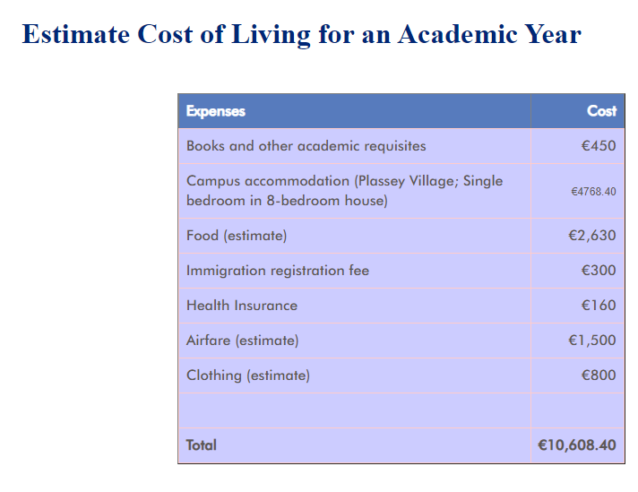

Slide 10
Thanks for Listening!
And questions to:
Felix95Schneider@gmx.de
Felix.Schneider@Uni-Wuppertal.de

